Slide 1
Why we cooperate with Labor Unions
Collective agreement as a result of social dialogue in social work. Benefits of the local government as the employer.
Kari Hesselberg
Head of Health and Social Care in Øvre Eiker Municipality

Slide 2
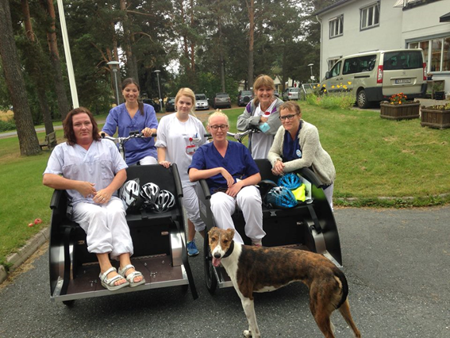
Because cooperation is useful
Health and social care; main goal: Providing services to the inhabitants of Øvre Eiker with good (correct) quality
The crucial moment that defines quality, is the meeting between the employee and the patient/user of service
An employee with competence and mastery is our main asset
Notes:
Because it is useful and the right thing to do

Slide 3
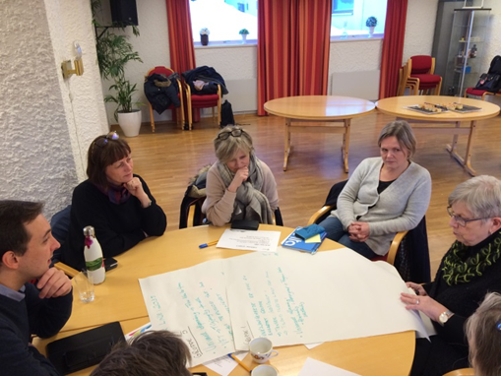
How we do it SMIA-groups in all workplaces («Smithy») Cooperative group for Dialogue and Inclusion at the Workplace
What purpose has SMIA?
Systematic development of the workplace
Employees have good ideas
Employees should experience mastery
Deliver quality services to inhabitants in Øvre Eiker
Who takes part?
Leader
Elected representatives of Labor Unions
Safety representative
Themes - examples:
Safety questions
Work environment
High percentage of sick leave
Innovations, changes and new ideas
Organizing work – planning shifts
Etc.

Slide 4
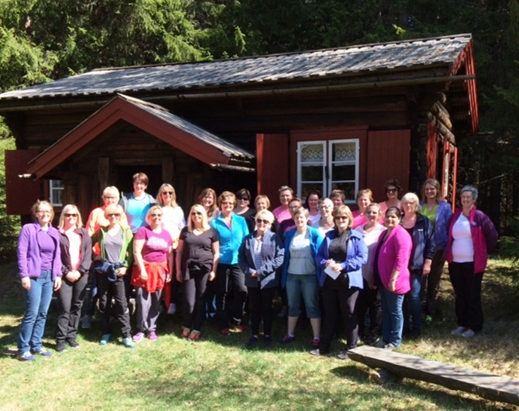
Regular dialogue at the workplace
Nurses, assistant nurses, and other employees have 3 different labor unions
Each union has elected representatives at every workplace and one centrally in the municipality
The local representative has dialogue with the local leader
The central representative has dialogue with the top leadership
We are approximately 30 leaders in Health and Social Care in Øvre Eiker Municipality on 3 levels. Regular dialogue with labor unions can be time-consuming.
But it helps getting things done!

Slide 5
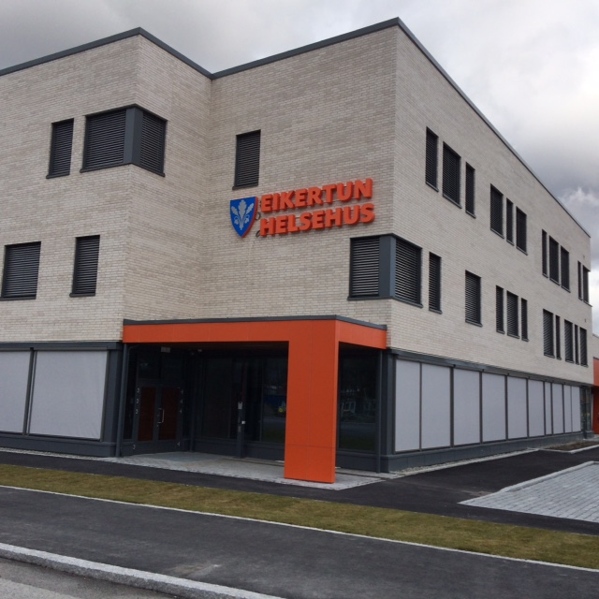
Two examples
We wanted to centralize and collect the nurses in home care, in one base to ensure common practice
Many against
We had lots of dialogue, information
We agreed in SMIA
Corona crisis made it necessary to change some employees work hours; from 7 hours shifts to 12 hours shifts
Representative for the Nurses Union at the municipal level was against
Representatives for Nurses and for Assistant Nurses at the workplace were pro
Dialogue – agreement – so far

Slide 6
What are the results?
Elected representatives know and understand operations
Representatives are well informed and included in respectful dialogue and they contribute to better decisions
A question of leadership
and of elected representatives having sufficient training and knowledge
The representatives contribute to implementing important and necessary changes
We respect each others roles and have the same goals for our services to our patients/users
The collective agreements (made by KS and the National Labor Unions) on wages, work hours, rights and duties is crucial and at the bottom of our cooperation and development locally

